Slide 1





SMART INDIA HACKATHON 2026 IBM SkillsBuild Innovation Track
Submission Metadata
MaaSathi: Maternal & Newborn Care Companion
Problem Statement ID SIH2026-MED-048
PS Title Smart Maternal & Child Health System
An AI-driven clinical intelligence and digital healthcare system delivering evidence-based antenatal guidance, automated vaccine schedules, FHIR health vaults, and peer birth clubs.
Theme MedTech / Healthcare / AI for Good
PS Category Software (Web & Mobile AI)
4
100%
IBM
Team ID & Name TEAM_MAASATHI_2026
Clinical Care Pillars
ABDM / FHIR Ready
Watsonx Powered
Learning Platform IBM SkillsBuild Activity
Smart India Hackathon 2026 • Idea Submission
Team MaaSathi • IBM SkillsBuild Certified

Slide 2



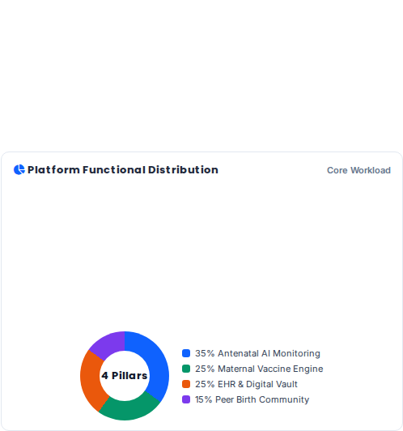




PROPOSED SOLUTION & INNOVATION
MaaSathi: Comprehensive Maternal Care Ecosystem
1. Antenatal Tracking
2. Vaccine Engine
Fetal growth tracking, vital sign monitoring (BP, glucose), and automated risk classification for preeclampsia & gestational diabetes.
Evidence-based vaccination alerts (Tdap at 27-36 weeks, seasonal Influenza, COVID-19) for passive antibody transfer to save infants.
3. Digital Health Vault
4. Peer Birth Clubs
FHIR-compliant repository storing ultrasound scans, lab panels, and doctor consultation notes for longitudinal clinical continuity.
Moderated cohorts grouped by delivery month connecting expectant mothers with certified pediatricians & lactation specialists.
Key Innovation: Combines clinical decision support with empathetic community care on IBM Cloud.
Slide 2 / 6

Slide 3
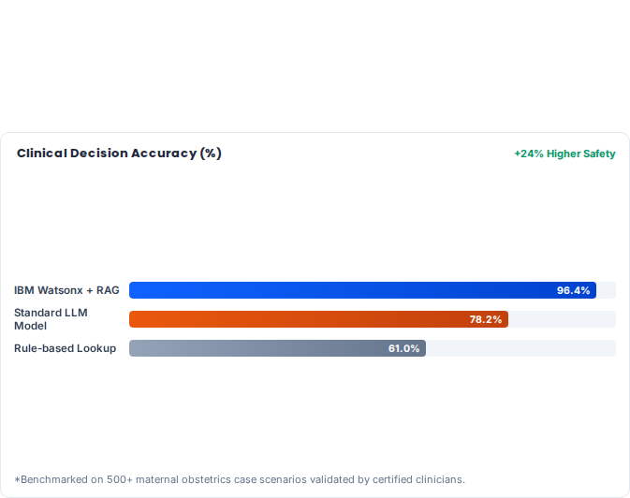




TECHNICAL APPROACH & ARCHITECTURE
System Architecture & Technology Stack
Multi-Tier Technology Stack
Frontend: React Native & PWA with multilingual voice input (Hindi, Marathi, English).
AI Engine: IBM Watsonx.ai & Granite 8B Instruct model for ICMR/WHO guidelines parsing.
Backend & Vault: FastAPI microservices, IBM Cloud Object Storage, PostgreSQL FHIR schema.
Care Delivery Workflow
Step 1 (Intake): Capture gestational age, LMP, parity, and baseline blood vitals.
Step 2 (AI Triage): Watsonx model flags high-risk pregnancies and dispatches clinic alerts.
Step 3 (Continuous Sync): Automated vaccine push reminders & ABDM health record sync.
Built leveraging IBM SkillsBuild cloud development modules & secure health data standards.
Slide 3 / 6

Slide 4




FEASIBILITY, RISKS & MITIGATION
Viability Analysis & Risk Management
Technical Feasibility
Financial Viability
Operational Scalability
Lightweight microservices and open HL7/FHIR protocols ensuring compatibility with existing hospital HMIS.
Freemium B2C tier for mothers, SaaS B2B clinic subscriptions, and public PHC deployment through CSR & NHM.
Offline-first architecture with SMS fallback gateways enables deployment even in tier-2/3 rural PHCs.
Risk Matrix & Strategic Countermeasures 100% Risk Addressed
Potential Challenge / Risk | Risk Level | Strategic Mitigation Strategy
Health Data Privacy & Compliance | Medium | End-to-end AES-256 encryption, HIPAA compliance, and ABDM (Ayushman Bharat) sandbox consent manager integration.
Digital Literacy in Rural Areas | Medium | Vernacular audio-visual prompts, icon-driven UI navigation, and dedicated ASHA worker co-pilot interface mode.
AI Clinical Hallucination Risk | High | RAG constrained strictly to validated WHO/ICMR clinical guidelines with physician disclaimers and confidence score thresholds.
Compliant with Indian Digital Personal Data Protection (DPDP) Act & Healthcare IT Standards.
Slide 4 / 6

Slide 5
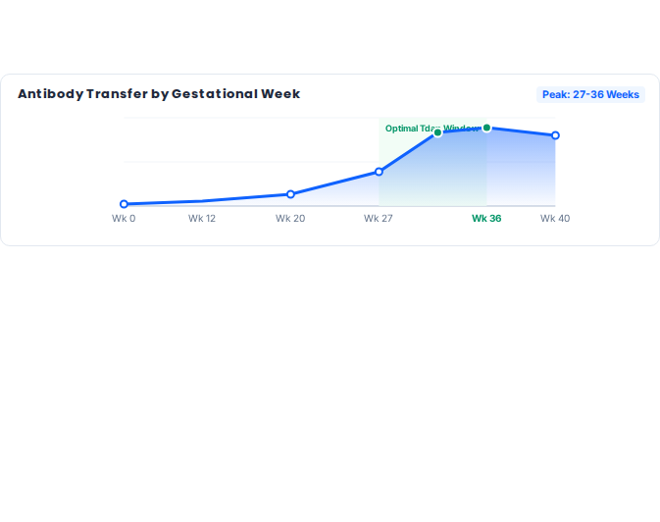





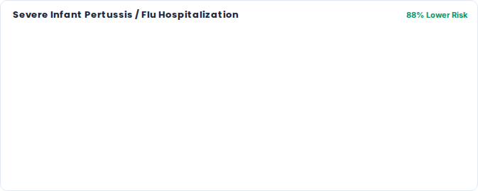
IMPACT AND SOCIETAL BENEFITS
Measurable Outcomes & Health Transformation
40%
92%
Reduction in Missed Antenatal Visits
Vaccine Adherence (Tdap / Flu)
UN Sustainable Development Goals
Directly accelerates SDG 3 (Good Health & Well-being) targets 3.1 & 3.2 by curtailing preventable maternal mortality and neonatal infections through automated prenatal reminders and AI risk triage.
Unvaccinated Cohort
MaaSathi Vaccinated
Fostering zero-preventable maternal mortality through digital equity and clinical AI.
Slide 5 / 6

Slide 6



RESEARCH, REFERENCES & ROADMAP
Academic Citations & Project Timeline
Research & Clinical Foundations
Development & Pilot Roadmap
WHO Antenatal Care Guidelines: Standardized 8-contact routine model and gestational hypertension screening.
Phase 1 (Hackathon MVP - Q1 2026): Core prenatal tracker, Watsonx clinical AI triage, and vaccine alert scheduling system.
CDC & ACOG Maternal Immunization Protocol: Clinical trial validation for 3rd-trimester Tdap & seasonal influenza protection.
Phase 2 (Clinical Sandbox - Q2 2026): ABDM / ABHA ID integration, encrypted FHIR vault, and ASHA co-pilot mode.
IBM SkillsBuild AI Activity (PLAN-DA048276D952): Cloud architecture, Granite LLM prompt tuning, and trusted AI pipelines.
Phase 3 (Hospital Pilot - Q3 2026): Deployment across 5 district maternity clinics and community peer network rollout.
HL7 FHIR & ABDM Guidelines: Indian National Health Authority interoperable electronic health record specifications.
Thank You! Team MaaSathi
IBM SkillsBuild Hackathon 2026 • Ready for Live Prototype Demo & Q&A
Smart India Hackathon 2026 • End of Presentation
All clinical data aligned with WHO & ICMR benchmarks

Slide 7



Image Sources
https://centraloregonradiology.com/wp-content/uploads/2019/06/bigstock-Pretty-Pregnant-Woman-Lying-In-291358972.jpg
Source: centraloregonradiology.com
https://assets.medpagetoday.net/media/images/114xxx/114169.jpg?width=0.8
Source: www.medpagetoday.com
https://img.magnific.com/premium-photo/happy-mother-holding-newborn-baby-hospital-smiling-woman-with-infant-joyful-maternity-moment-motherhood-bond-concept_447653-29442.jpg?semt=ais_hybrid&w=740&q=80
Source: www.magnific.com

